Slide 1

Dentin
RUNGTA COLLEGE OF DENTAL SCIENCES & RESEARCH
DEPARTMENT OF ORAL PATHOLOGY

Slide 2
Specific learning Objectives
Core areas* | Domain ** | Category #
Introduction to dentin | COGNITIVE | MUST KNOW
Physical and chemical properties Classification of dentin Structure of dentin Functions of dentin Dentinogenesis Age changes of dentin | COGNITIVE COGNITIVE COGNITIVE COGNITIVE COGNITIVE COGNITIVE | MUST KNOW MUST KNOW MUST KNOW MUST KNOW MUST KNOW

Slide 3
Contents
Introduction to dentin
Physical and chemical properties
Classification of dentin
Structure of dentin
Functions of dentin
Dentinogenesis
Age changes of dentin

Slide 4
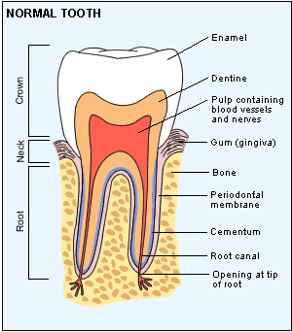
DENTIN

Slide 5
DENTIN
Introduction
Provides bulk and generalized form to the tooth
Is an ectomesenchymal derivative
First formed dental hard tissue – odontoblast (DP)
Crown – covered by enamel
Root – covered by cementum

Slide 6
Physical properties
Color:
  Light yellowish
  Becomes darker with age (dark yellowish)
Hardness:
  Harder than bone & cementum
  Softer than enamel – more radiolucent
  Enamel > Dentin > Bone > Cementum
95-96%
65-70%
60-65%
50-55%

Slide 7
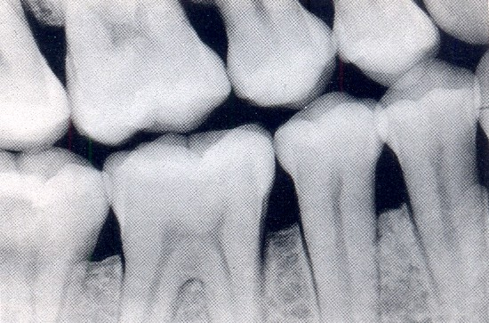
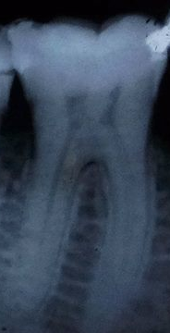
Dentin - less radiopaque than enamel
( because of decreased mineral content )
E
D
P
E
D
P

Slide 8
Strength :
  Greater compressive strength and flexural strength than enamel – accounts for elasticity – thus can be deformed to a certain limit
Permeability :
  Depends on size and patency of tubules which will decline with age (increases with age)
Thickness:
  3-7 mm
  Thicker in boys
  Buccal > Lingual
  Increases with age

Slide 9
Chemical composition
DENTIN
INORGANIC
(65%)
Ca, Ph, Mg, Na, Fe, Zn, Cu, Fluorides
ORGANIC & Water
(35%)
Cells, Fibres, Ground substances
HYDROXYAPATITE
Ca and P
Type I, III, IV
COLLAGEN
NON COLLAGENOUS
PROTIENS
Proteoglycan
Glycoprotein
Dentinsialoprotein (DSP)
Dentinphosphoprotein (DPP)
Osteopontin (OP)
Growth factors
BMP
FGF
PDGF

Slide 10
FUNCTIONS
Protects the soft connective tissue of pulp.
Forms the main bulk of tooth & gives form to tooth (shape & size).
Induces differentiation of ameloblasts.
Healing (Tertiary dentin formation).
Sensory (contains myelinated nerves).

Slide 11
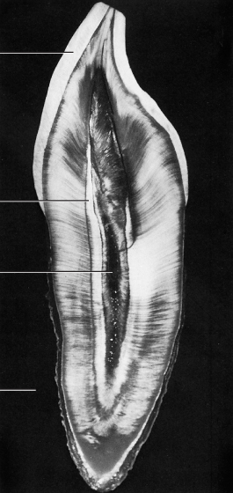
Structure of Dentin
Dentinal tubules
Intertubular dentin
Peritubular dentin
Odontoblastic processes
Predentin
Interglobular dentin
Incremental lines
Neonatal line
Tome’s granular layer

Slide 12
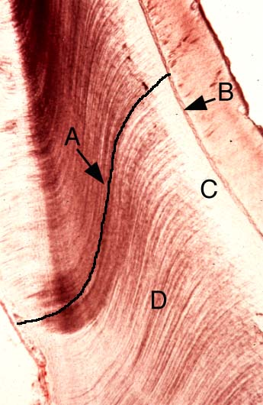
Dentinal tubules
pulp
Main content of dentin
COURSE:
  S shaped curve –
  called PRIMARY CURVATURE
  Doubly curved course :
  starting at right angles to the pulpal surface and ending perpendicular to the DEJ and CDJ
DEJ

Slide 13
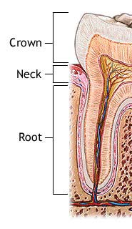
EXTENT :
  Crown – DEJ to pulp
  Root – CDJ to pulp
  Tubules are longer than the thickness of dentin
DEJ
CDJ

Slide 14
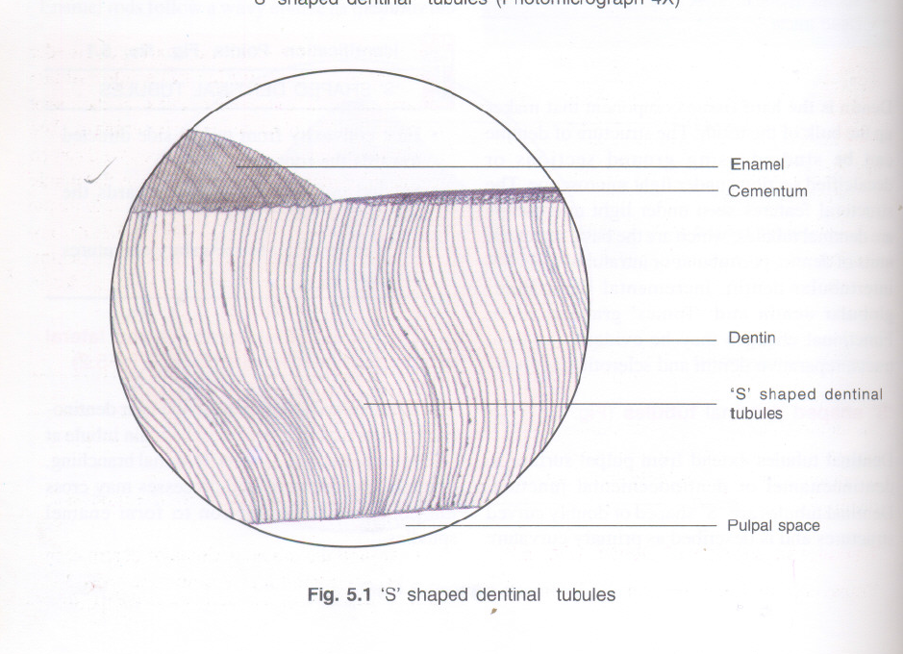

Slide 15
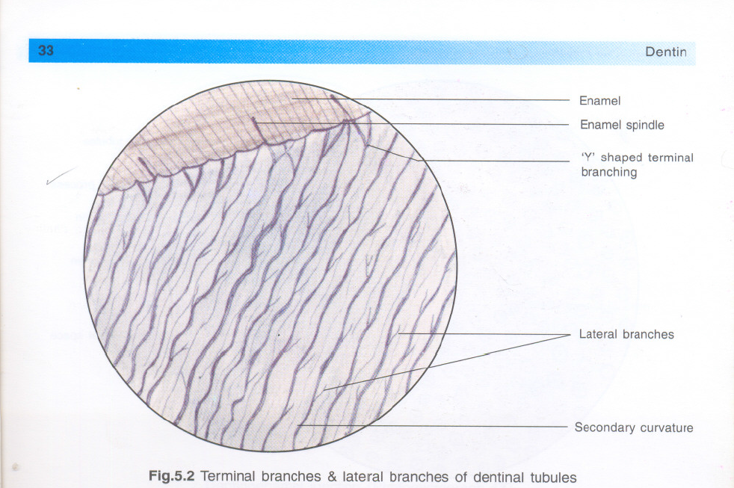

Slide 16
Types of dentin
Coronal dentin
Radicular dentin
Predentin
Intertubular dentin
Peritubular dentin
Interglobular dentin
Primary dentin
Secondary dentin
Tertiary dentin
Based on extent
Based on location
Based on time of formation

Slide 17
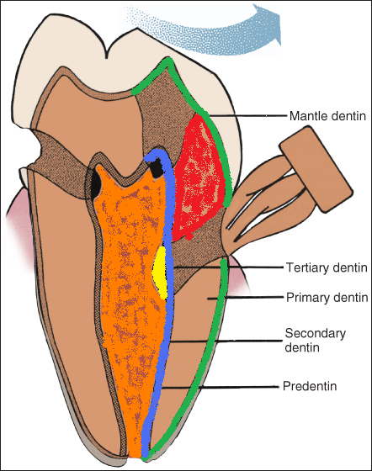
Primary dentin
  Mantle dentin
  Circumpulpal dentin
Tertiary dentin
Also called as:
  Reactionary dentin
  Reparative dentin
  Osteodentin

Slide 18
Coronal
dentin
Radicular
dentin

Slide 19
Peritubular dentin / Intratubular dentin
Immediately surrounds the dentinal tubules
Forms the wall of tubules
Highly mineralized (9%) than intertubular dentin
Lost after decalcification –as they are highly mineralised and appear as empty space surrounding the odontoblastic process

Slide 20
Intertubular dentin
Constitutes the main body of the dentin
Located between the dentinal tubules or between zones of peritubular dentin
Mineralised but retained after decalcification

Slide 21
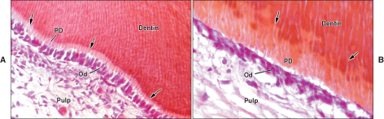
As organic matrix undergo mineralisation predentin becomes dentin and a new layer of predentin is formed
In mineralised dentin:
collagen fibrils are of larger diameter (100nm)
& more closely packed than in predentin

Slide 22
Primary dentin
  ? Primary
  Because it is the dentin which is formed prior to the root completion.
  2 types :-
  Mantle dentin
  Circumpulpal dentin

Slide 23
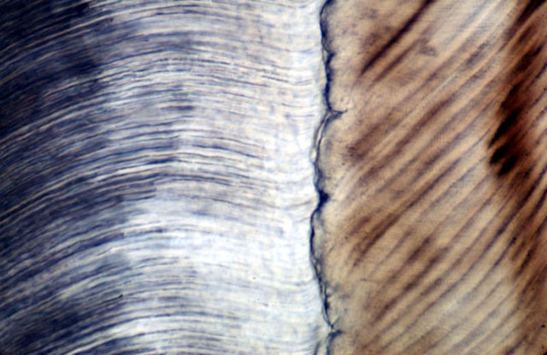
Mantle dentin
Dentin
DEJ
Enamel
First formed mineralised dentin
Outermost / peripheral part of primary dentin
Seen in the crown below the DEJ
  Mantle dentin

Slide 24
Enamel
Mantle Dentin
Dentin
Circumpulpal
Dentin
Pulp

Slide 25
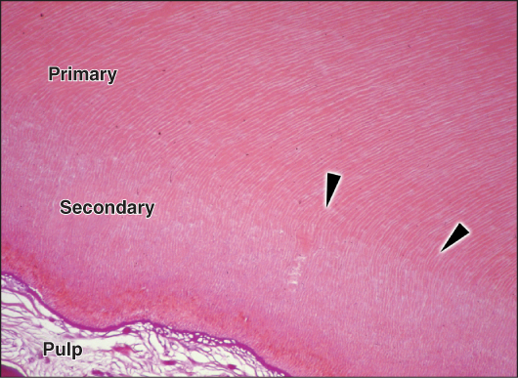
Formed more slowly than primary dentin
Not formed uniformly
  More on the roof and floor of the pulp chamber
Tubules appear more regular (Regular secondary dentin)

Slide 26
Odontoblastic process / Tomes fibres
Enamel
These are cytoplasmic extensions of the odontoblasts
Odontoblasts are seen inside the pulp (at pulp periphery) but their processes extend into the dentinal tubules
Dentin
Pulp

Slide 27
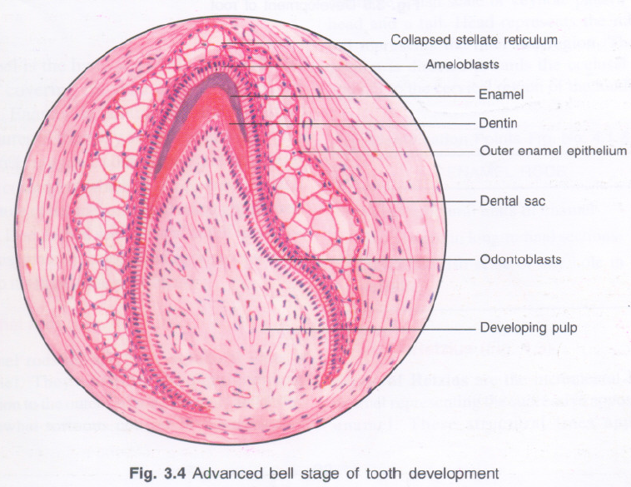

Slide 28
Enamel
Enamel spindles
Dentin
Pulp

Slide 29
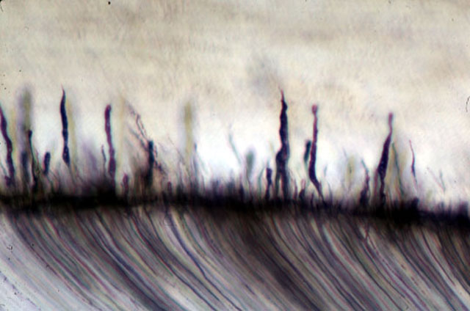
Extent of odontoblastic processes into enamel –
Enamel spindles
Consists of microtubules (20 μm) and small filament (5-7.5 μm)
Also contains mitochondria, dense bodies, lysosomes, microvesicles, coated vesicles
Enamel
Enamel
Spindles
Dentin

Slide 30
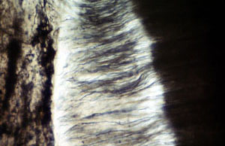
Tertiary dentin
Reactive, reparative, or irregular secondary dentin
Localised formation of dentin on the pulp dentin border - Produced only by odontoblast cells directly affected by insult to tooth

Slide 31
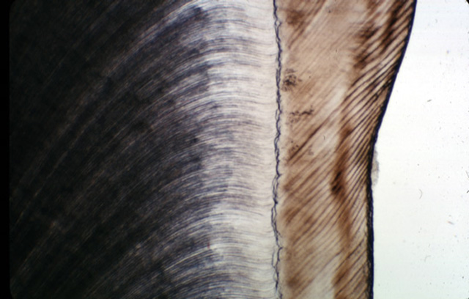
DEJ (Dentinoenamel Junction)
Shape - Scalloped
  Due to high shearing forces
  Convexity towards dentin
  Concavity towards enamel
Smooth on lateral surfaces
Function : interdigitation enables Firm Adherence

Slide 32
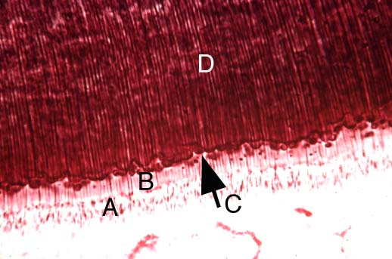
Interglobular dentin
Areas of hypomineralised / unmineralised dentin
Found in crown of teeth in the circumpulpal dentin just below mantle dentin where pattern of mineralisation is largely globular

Slide 33
Interglobular dentin
Mineralization of dentin = smaller globular areas
Globular areas , fail to combine / coalesce into a homogeneous mass
This results in zones of hypomineralization between the globules

Slide 34
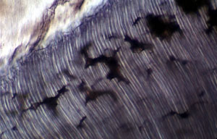
Formed due to failure of globular zones of mineralisaton to fuse into a homogenous mass within mature dentin
Due to Vitamin D deficiency / excess of fluoride – during dentinogenesis
Dry ground sections - filled with air - appear black in transmitted light

Slide 35
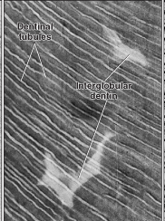
Dentinal tubules run uninterruptedly through the interglobular area
No intratubular dentin is present where the tubules pass through the globules

Slide 36
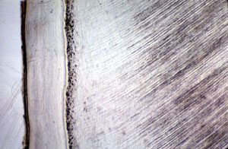
Tomes granular layer
In dry ground sections – granular zone adjacent to cementum in transmitted light.
Seen only in root dentin
Increases in amount from CEJ to root apex
Caused by coalescing and looping of terminal portions of dentinal tubules
cementum
dentin

Slide 37
Increases in amount from CEJ to root apex

Slide 38
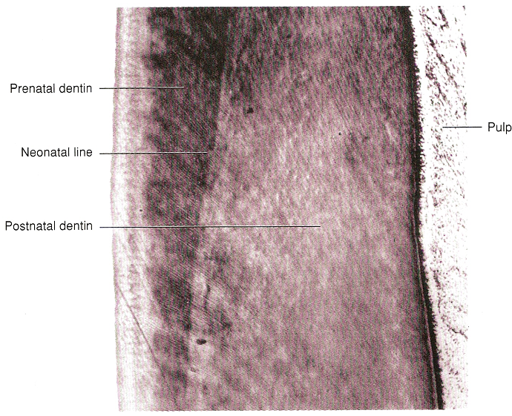
Neonatal line
Accentuated contour line
Seen in deciduous teeth and permanent first molars
Reflects abrupt change in environment that occurs at birth

Slide 39
Dentin sensitivity theories / Theories of pain transmission through dentin
3 theories for pain transmission :
  DIRECT NEURAL STIMULATION
  TRANSDUCTION THEORY
  FLUID / HYDRODYNAMIC THEORY

Slide 40
Direct neural stimulation
Stimuli ( heat, cold, air blast dessication, mechanical or osmotic pressure )
Directly reach the nerve endings in the inner dentin
Stimulate the pain transmission fibres (A∂ nerve fibres )
Transmits pain
Nerve fibres from pulp reaches into the dentin

Slide 41
Transduction theory
Nerve is not stimulated directly
Odontoblastic process is excited by the stimulus
This excitation impulse is transmitted to nerve endings via neurotransmitters in the inner dentin
Nerve fibres remain inside the pulp & doesn’t reach into dentin

Slide 42
Hydrodynamic theory
Most popular and accepted theory
Hydro = Fluid / Water
Dynamic = movement
Content of Dentinal tubules – Odontoblastic processes + Dentinal fluid (dental lymph)

Slide 43
Stimuli
Dentinal tubules contain dentinal fluid (dental lymph). Stimuli affect fluid movement in the dentinal tubules
Fluid movement – inward (cold stimuli) / outward (hot/dry stimuli)
This movement dentinal fluid causes mechanical disturbance of the nerves associated with odontoblast & transmits pain

Slide 44
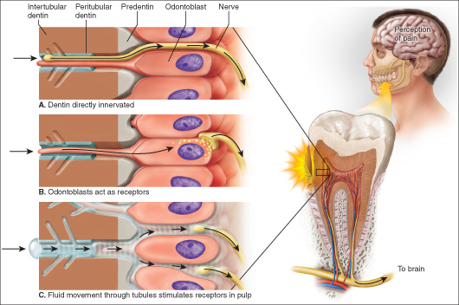

Slide 45
DENTINOGENESIS

Slide 46
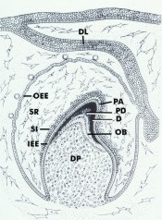
Dentin formation begins at late (advanced ) bell stage
At the tip of folded IEE cells
(this is the site at which cuspal development begins)
From this site the Dentinogenesis spreads down the cusp slope till --------- cervical loop

Slide 47
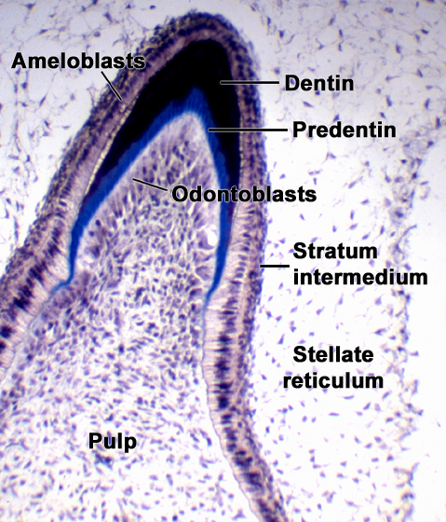

Slide 48
Initial step - Odontoblast differentiation
Cells of inner enamel epithelium (IEE) - Ameloblasts.
Ameloblasts stimulate Dental papilla cells - Their shape changes from ovoid to tall columnar (differentiated odontoblasts)

Slide 49
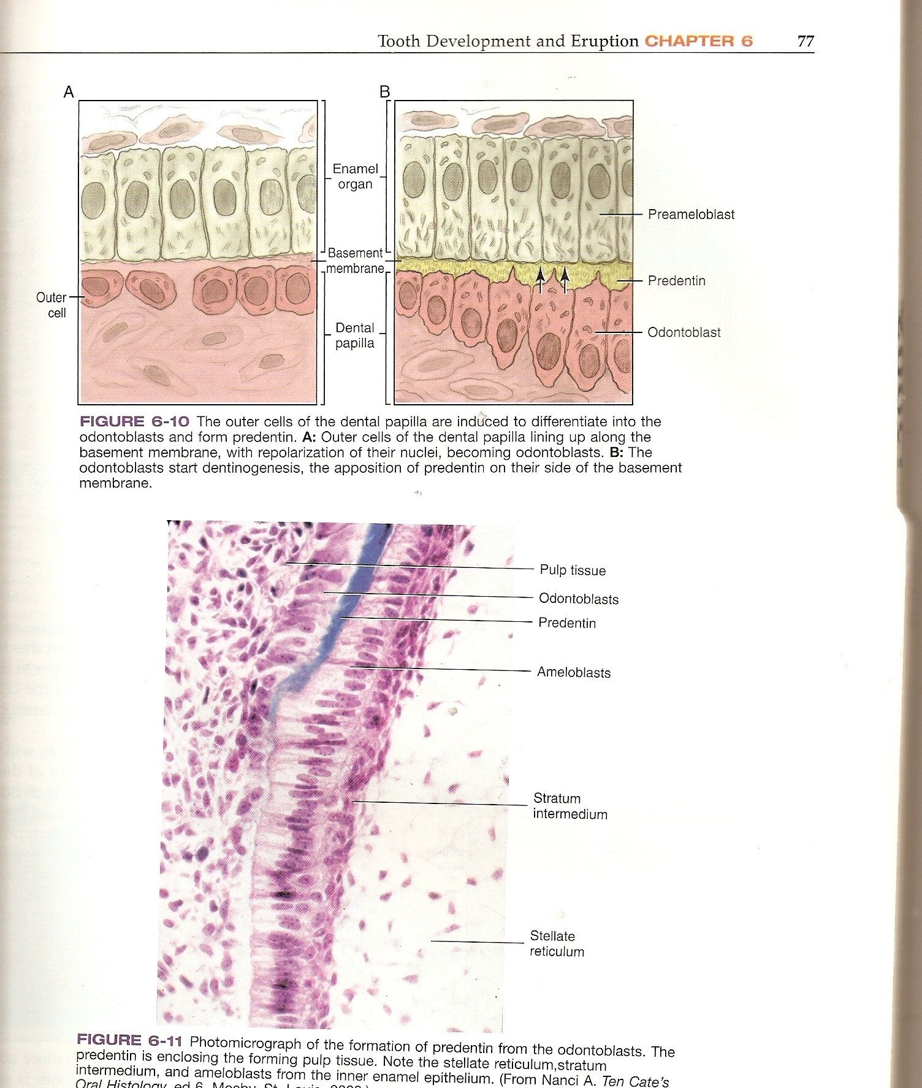
CHANGES IN ODONTOBLASTS :-
Ovoid to columnar shape
Nucleus become basally
Increased cell organelles

Slide 50
FUNCTION OF ODONTOBLAST
Formation of dentin Mantle Circumpulpal
This involves 2 steps: Matrix formation / deposition (collagen matrix formation) Mineralisation (deposition of hydroxyapatite)

Slide 51
Dentinogenesis 2 phase process
Odontoblastic Differentiation
1st phase – deposition of organic matrix (collagen, non-collagenous proteins)
2nd phase – mineralization of organic matrix

Slide 52
Deposition of Dentin / Matrix formation
Once odontoblasts differentiate – lay down the organic extracellular matrix of dentin composed of :
Type I collagen
Dentin phosphoprotein (DPP),
Osteopontin (OP),
Dentin Sialoprotein (DSP)
& noncollagenous matrix vesicles.

Slide 53
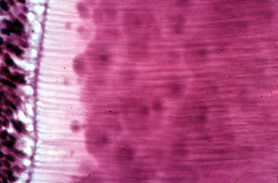
The first zone of unmineralized dentin - PREDENTIN
Located adjacent to pulp tissue
2-6 μm wide
unmineralised dentin
Pale stained than mineralized dentin
Pulp
Predentin
Dentin

Slide 54
MATRIX VESICLES
Contain alkaline phosphatase
This increases concentration of phosphates – binds with Calcium = calcium phosphate
Hydroxyapatite

Slide 55
Growth of this initial crystal is followed by further growth of closely associated crystals.
Further mineralisation spreads ciumferentially to form small noduli that eventually fuse

Slide 56
PATTERN OF MINERALIZATION
Mineralization occurs by globular calcification (Calcospheric / spherulite form)
This involves the deposition of crystals in several discrete areas of the matrix
Dentin deposited : 4 μm / day
With continued growth, globular masses are formed that continue to grow / enlarge & fuse to form a single mass (heterogenous)

Slide 57
Age changes
Reparative dentin
Dead tracts
Sclerotic dentin

Slide 58
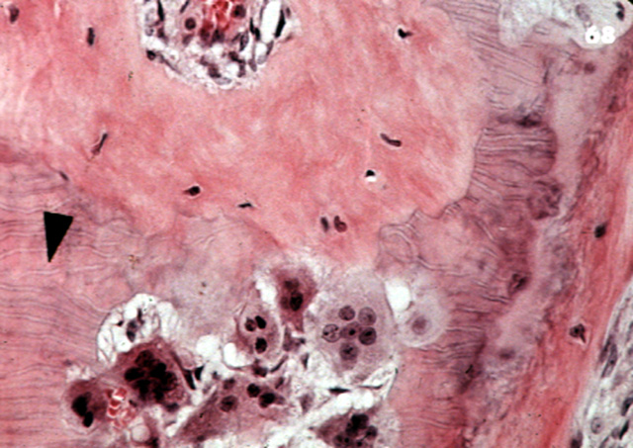
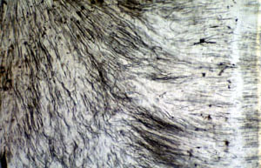
Reparative dentin
Also called :-
Reactionary
Regenerative
Irregular secondary dentin

Slide 59
Abrasion / Caries / operative procedure / insult
Odontoblast cells & process are cut/exposed depending upon type of injury (Cells may die or survive)
Died odontoblast cells are replaced by newly differentiated odontoblast from pulp
Begin deposition of reparative dentin (seal off the zone of injury as a part of healing process)

Slide 60
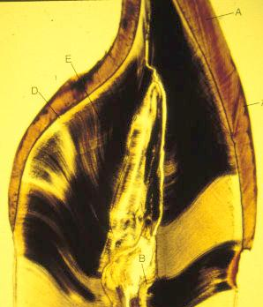
Dead tracts
In dried ground sections of normal dentin
Odontoblastic process may be lost (due to stimuli) – especially in incisal/cuspal areas due to crowding of odontoblasts
Odontoblastic processes disintegrate and the empty tubules are filled with air & appear dark

Slide 61
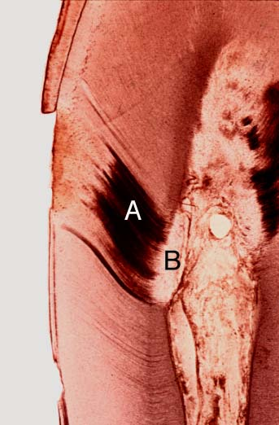
Sclerotic dentin
Stimuli – (caries, attrition, abrasion, erosion, etc..)
Collagen fibres and apatite crystals appear in the dentinal tubules & obliterates the lumen of the tubule
Refractive indices get equalized & appear clear - Also called transparent dentin

Slide 62
Summary
Dentin is the most voluminous structural component of human tooth. Dentin protects pulp tissue from microbial and other noxious stimuli. Dentin consists of a large quantity of small parallel tubules that lay within a collagen matrix, which is highly mineralized. It also provides essential support to enamel and is highly mineralized and thus enables fragile enamel to withstand occlusal and masticatory forces without fracturing.

Slide 63
Take home message
Dentin is the most voluminous structural component of human tooth. Dentin protects pulp tissue from microbial and other noxious stimuli. Dentin consists of a large quantity of small parallel tubules that lay within a collagen matrix, which is highly mineralized.

Slide 64
References
SN Bhaskar . Orban’s ,Oral Histology and embryology. 11th edition, Mosby 1998
Neville BW ,Damm DD ,Allen CM ,Bouquot JE . Oral and maxillofacial pathology , 2nd Edition .Philadelphia W.B. Saunders ;2002
Richard Tencate , Oral Histology development ,structure and function . 5th Edition ,1998
Carranza F.A., Michael G. Newman . Clinical periodontology 8,9,10th edition

Slide 65
Frequentely Asked Questions
Define & classify types of dentin. Write about various structures of dentin. Add a note on chemical composition of dentin
Theories of dentin sensitivity
Age changes of dentin
Dentinogenesis
Functions of dentin
Classification of dentin

Slide 66
THANKYOU

